Slide 2
Controllers (PID) SS model of Motors Additional sums in Controllability & Observability

Slide 3
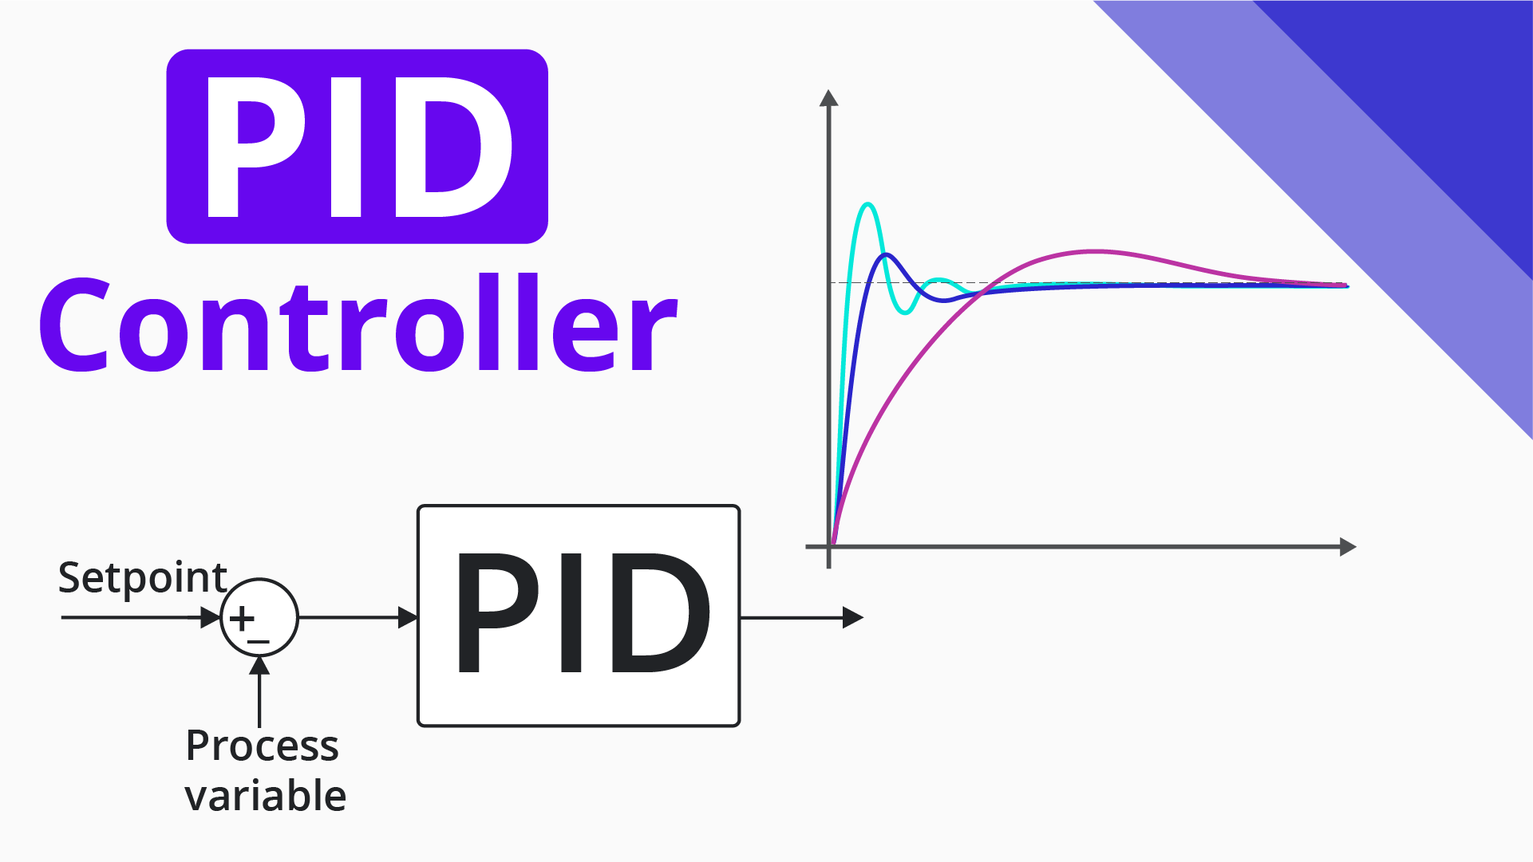
PID controllers

Slide 4
Controllers
PID controller maintains the output such that there is zero error between the process variable and setpoint/ desired output by closed-loop operations.
PID uses three basic control behaviors as P, I & D

Slide 5
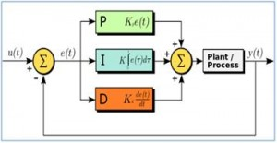
Controllers

Slide 6
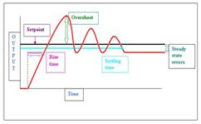
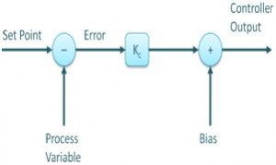
P controller
Proportional (P) Term
Reacts to the present error.
P- controller gives an output that is proportional to current error e (t)
Formula: Pout = Kp e(t)

Slide 7
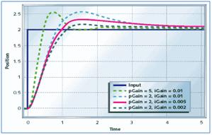
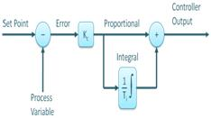
I controller
Integral (I) Term
Accounts for past errors by integrating the error over time.
Helps eliminate steady-state errors.
Formula: out = Ki ∫e(t)

Slide 8
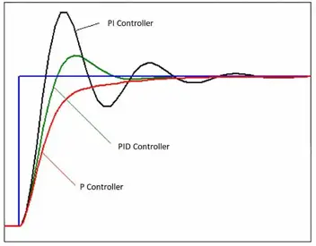
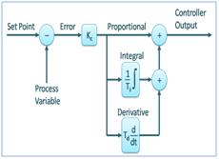
D controller
Derivative (D) Term
Predicts future errors by calculating the rate of change.
Helps improve stability and prevent overshoot.
Formula: Dout = Kd de(t)/dt

Slide 9

PID controller
PID formula:
u(t)=Kp​ e(t) + Ki ​∫e(t)dt + Kd de(t)/dt​ {OR}
where:
Kp​ = Proportional gain
Ki​ = Integral gain
Kd​ = Derivative gain
PID stands for Proportional-Integral-Derivative. These three controllers are combined in such a way that it produces a control signal.

Slide 10
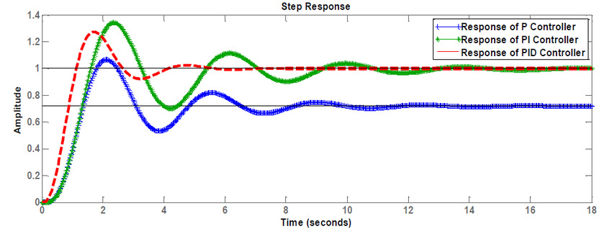
PID response

Slide 11
Comparing P, PI, PID
P Controller (dashed line) reacts quickly but has steady-state error.
PI Controller (dash-dot line) reduces the error but takes longer to settle.( will have overshoot too)
PID Controller (solid line) provides the best balance with minimal overshoot and fast settling.

Slide 12
Applications of PID Controllers
Temperature control (HVAC, industrial ovens)
Speed control (motors, drones, robotics)
Pressure control (hydraulic and pneumatic systems)
Level control (tanks, reservoirs)

Slide 13
SS MODEL OF MOTOR
Armature control
Field control

Slide 14
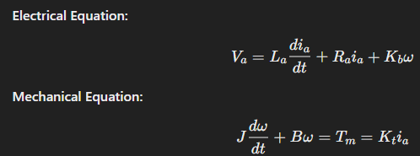
SS MODEL OF MOTOR
Armature control:

Slide 15
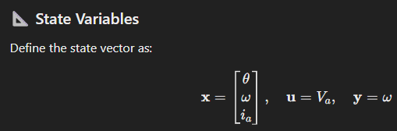
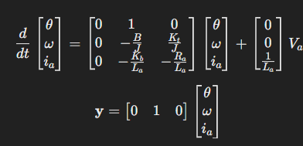
System of equations:

Slide 16
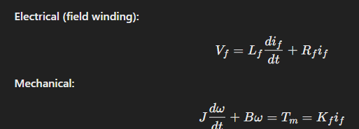
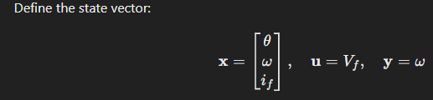
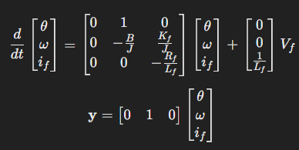
Field control:
State variables&
state vector
System eqns :

Slide 17
(7.4.25) Additional sums…to practice..

Slide 18
Additional sums
The Eigen values are
(i) 1,-2,3 (ii) 1,2,3 (iii) -1,-2,-3 (iv) -1,2,-3

Slide 19
Additional sums
1. Check whether the system is controllable or not?

Slide 20
Additional sums
2. Check the controllability & Observability of the following state model

Slide 21
Additional sums
4. Check the controllability & Observability of the following state model

Slide 22
Additional sums
3. Check the controllability & Observability of the following state model

Slide 23
THANK YOU

